Slide 1

The BIRCH Algorithm
Faculty of Electrical Engineering
University of Belgrade
Davitkov Miroslav, 2011/3116

Slide 2
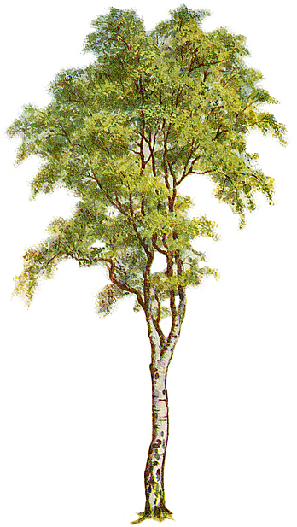
1. BIRCH – the definition
Balanced
Iterative
Reducing and
Clustering using
Hierarchies
2 / 32

Slide 3
1. BIRCH – the definition
An unsupervised data mining algorithm used to perform hierarchical clustering over particularly large data-sets.
3 / 32

Slide 4
2. Data Clustering
Cluster
A closely-packed group.
- A collection of data objects that are similar to one another and treated collectively as a group.
Data Clustering - partitioning of a dataset into clusters.
4 / 32

Slide 5
2. Data Clustering – problems
Data-set too large to fit in main memory.
I/O operations cost the most (seek times on disk are orders of a magnitude higher than RAM access times).
BIRCH offers I/O cost linear in the size of the dataset.
5 / 32

Slide 6
2. Data Clustering – other solutions
Probability-based clustering algorithms
(COBWEB and CLASSIT)
Distance-based clustering algorithms
  (KMEANS, KMEDOIDS and CLARANS)
6 / 32

Slide 7
3. BIRCH advantages
It is local in that each clustering decision is made without scanning all data points and currently existing clusters.
It exploits the observation that data space is not usually uniformly occupied and not every data point is equally important.
It makes full use of available memory to derive the finest possible sub-clusters while minimizing I/O costs.
It is also an incremental method that does not require the whole dataset in advance.
7 / 32

Slide 8
4. BIRCH concepts and terminology
Hierarchical clustering
8 / 32

Slide 9
4. BIRCH concepts and terminology
Hierarchical clustering
  The algorithm starts with single point clusters
  (every point in a database is a cluster).
  Then it groups the closest points into separate clusters, and continues, until only one cluster remains.
  The computation of the clusters is done with a help of distance matrix (O(n²) large) and O(n²) time.
9 / 32

Slide 10
4. BIRCH concepts and terminology
Clustering Feature
The BIRCH algorithm builds a clustering feature tree (CF tree) while scanning the data set.
Each entry in the CF tree represents a cluster of objects and is characterized by a triple (N, LS, SS).
10 / 32

Slide 11
4. BIRCH concepts and terminology
Clustering Feature
Given N d-dimensional data points in a cluster,
X_{i} (i = 1, 2, 3, … , N)
CF vector of the cluster is defined as a triple CF = (N,LS,SS):
N - number of data points in the cluster
LS - linear sum of the N data points
SS - square sum of the N data points
11 / 32

Slide 12
4. BIRCH concepts and terminology
CF Tree
a height balanced tree with two parameters:
- branching factor B
- threshold T
Each non-leaf node contains at most B entries of the form [CF_{i}, child_{i}], where child_{i} is a pointer to its i-th child node and CF_{i} is the CF of the subcluster represented by this child.
So, a non-leaf node represents a cluster made up of all the subclusters represented by its entries.
12 / 32

Slide 13
4. BIRCH concepts and terminology
CF Tree
A leaf node contains at most L entries,
each of them of the form [CF_{i}], where i = 1, 2, …, L .
It also has two pointers, prev and next,
which are used to chain all leaf nodes together
for efficient scans.
A leaf node also represents a cluster
made up of all the subclusters represented by its entries.
But all entries in a leaf node must satisfy
a threshold requirement, with respect to a threshold value T:
the diameter (or radius) has to be less than T.
13 / 32

Slide 14
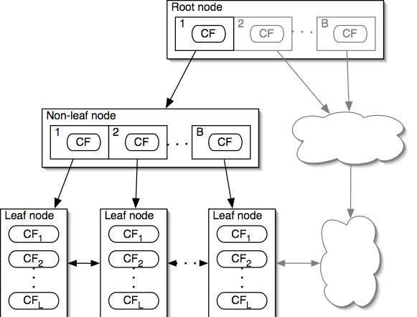
4. BIRCH concepts and terminology
CF Tree
14 / 32

Slide 15
4. BIRCH concepts and terminology
CF Tree
  The tree size is a function of T (the larger the T is, the smaller the tree is).
  We require a node to fit in a page of size of P .
  B and L are determined by P (P can be varied for performance tuning ).
  Very compact representation of the dataset because each entry in a leaf node is not a single data point but a subcluster.
15 / 32

Slide 16
4. BIRCH concepts and terminology
CF Tree
  The leave contains actual clusters.
  The size of any cluster in a leaf is not larger than T.
16 / 32

Slide 17
5. BIRCH algorithm
  An example of the CF Тree
  Initially, the data points in one cluster.
root
A
A
17 / 32

Slide 18
5. BIRCH algorithm
  An example of the CF Тree
  The data arrives, and a check is made whether the size of the
  cluster does not exceed T.
root
A
T
A
18 / 32

Slide 19
5. BIRCH algorithm
  An example of the CF Тree
  If the cluster size grows
  too big, the cluster is split
  into two clusters,
  and the points
  are redistributed.
root
A
B
B
T
A
19 / 32

Slide 20
5. BIRCH algorithm
  An example of the CF Тree
  At each node of the tree,
  the CF tree keeps information about the mean of the
  cluster, and the mean
  of the sum of squares to
  compute the size of the
  clusters efficiently.
root
A
B
A
B
20 / 32

Slide 21
5. BIRCH algorithm
  Another example of the CF Tree Insertion
LN3
LN2
Root
sc4
sc5
sc7
sc6
LN1
sc3
sc1
LN1
LN2
LN3
sc8
sc2
sc8
sc1
sc2
sc3
sc4
sc5
sc6
sc7
21 / 32

Slide 22
5. BIRCH algorithm
  Another example of the CF Tree Insertion
If the branching factor of a leaf node can not exceed 3, then LN1 is split.
LN3
LN2
Root
sc4
sc5
sc7
sc6
LN1’
LN1’’
LN1’
LN1’’
LN2
LN3
sc1
sc3
sc8
sc2
sc8
sc1
sc2
sc3
sc4
sc5
sc6
sc7
22 / 32

Slide 23
5. BIRCH algorithm
  Another example of the CF Tree Insertion
If the branching factor of a non-leaf node can not exceed 3,
then the root is split and the height of the
CF Tree increases by one.
Root
LN3
NLN1
NLN2
sc4
sc5
sc7
LN2
sc6
NLN2
LN1’’
LN1’
LN1’’
LN2
LN3
NLN1
sc3
sc1
sc2
sc8
LN1’
sc8
sc1
sc2
sc3
sc4
sc5
sc6
sc7
23 / 32

Slide 24
5. BIRCH algorithm
Phase 1: Scan all data and build an initial in-memory CF tree, using the given amount of memory and recycling space on disk.
Phase 2: Condense into desirable length by building a smaller CF tree.
Phase 3: Global clustering.
Phase 4: Cluster refining – this is optional, and requires more passes over the data to refine the results.
24 / 32

Slide 25
5. BIRCH algorithm
5.1. Phase 1
Starts with initial threshold, scans the data and inserts points into the tree.
If it runs out of memory before it finishes scanning the data,
it increases the threshold value and
rebuilds a new, smaller CF tree,
by re-inserting the leaf entries from the older tree and
then resuming the scanning of the data from the point at which it was interrupted.
Good initial threshold is important but hard to figure out.
Outlier removal (when rebuilding tree).
25 / 32

Slide 26
5. BIRCH algorithm
5.1. Phase 2 (optional)
Preparation for Phase 3.
Potentially, there is a gap between the size of Phase 1 results and the input range of Phase 3.
It scans the leaf entries in the initial CF tree to rebuild a smaller CF tree, while removing more outliners and grouping crowded subclusters into larger ones.
26 / 32

Slide 27
5. BIRCH algorithm
5.1. Phase 3
Problems after Phase 1:
  Input order affects results.
  Splitting triggered by node size.
Phase 3:
  It uses a global or semi-global algorithm to cluster all leaf entries.
  Adapted agglomerative hierarchical clustering algorithm is applied directly to the subclusters
  represented by their CF vectors.
27 / 32

Slide 28
5. BIRCH algorithm
5.1. Phase 4 (optional)
Additional passes over the data to correct inaccuracies and refine the clusters further.
It uses the centroids of the clusters produced by Phase 3 as seeds, and redistributes the data points to its closest seed to obtain a set of new clusters.
Converges to a minimum (no matter how many time is repeated).
Option of discarding outliners.
28 / 32

Slide 29
5. Conclusion
Pros
Birch performs faster than existing algorithms
(CLARANS and KMEANS) on large datasets.
Scans whole data only once.
Handles outliers better.
Superior to other algorithms in stability and scalability.
29 / 32

Slide 30
5. Conclusion
Cons
Since each node in a CF tree can hold only a limited number of entries due to the size,
a CF tree node doesn’t always correspond to what a user may consider a nature cluster.
Moreover, if the clusters are not spherical in shape,
it doesn’t perform well because it uses the notion of radius or diameter to control the boundary of a cluster.
30 / 32

Slide 31
5. References
T. Zhang, R. Ramakrishnan and M. Livny:
BIRCH : An Efficient Data Clustering Method for Very Large Databases
T. Zhang, R. Ramakrishnan and M. Livny:
A New Data Clustering Algorithm and Its Applications
31 / 32

Slide 32
Thank you for your attention!
Questions?
davitkov.miroslav@gmail.com
dm113116m@student.etf.rs

